Slide 1
AWS DEVOPS

Slide 2
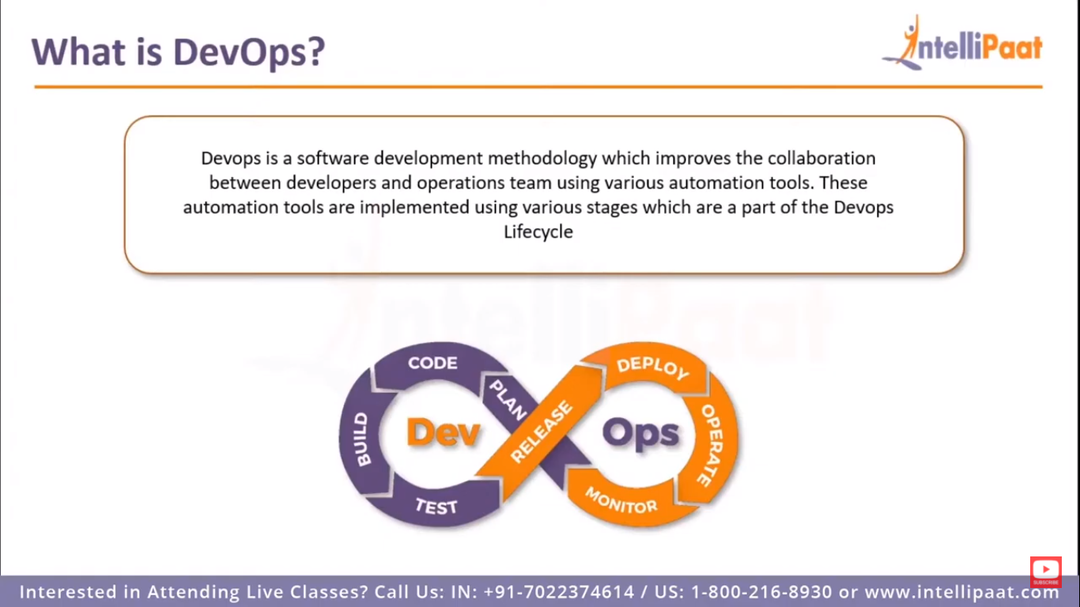

Slide 3
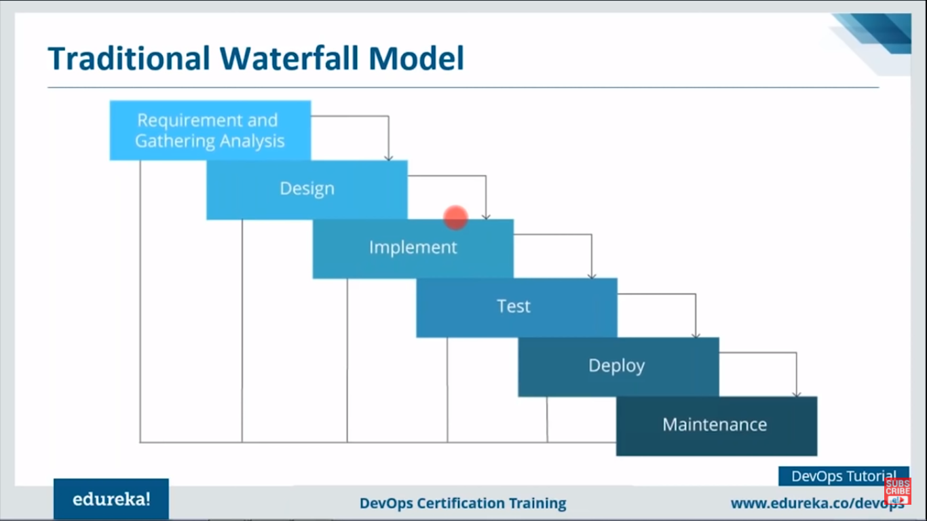

Slide 4
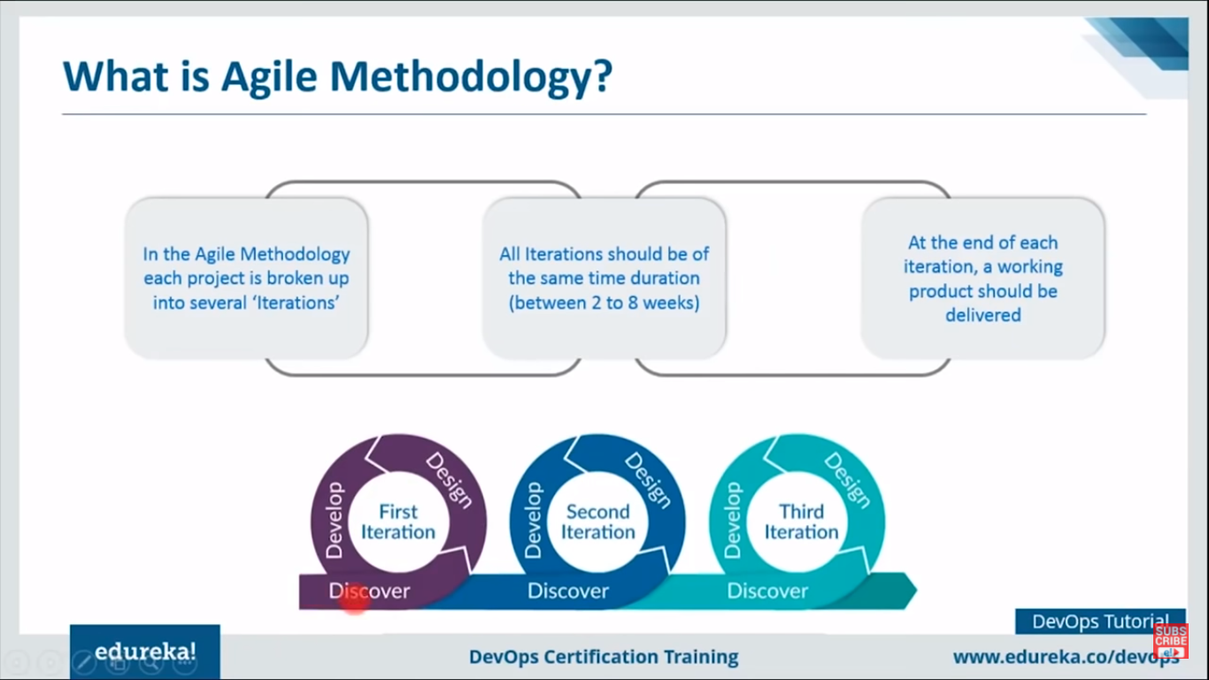

Slide 5
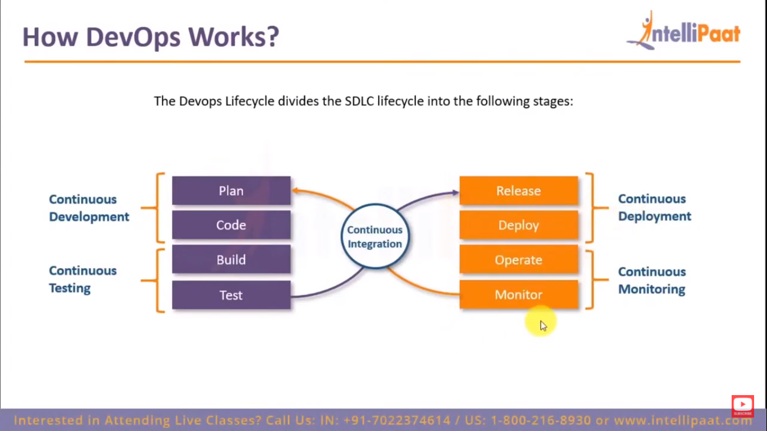

Slide 6
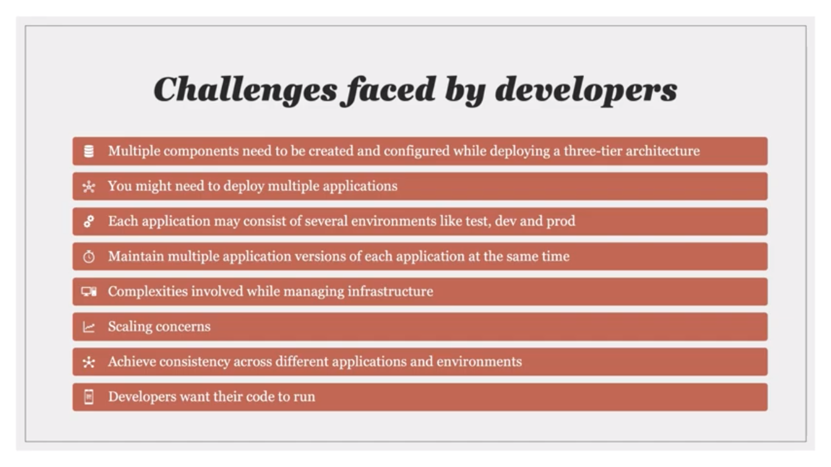

Slide 7
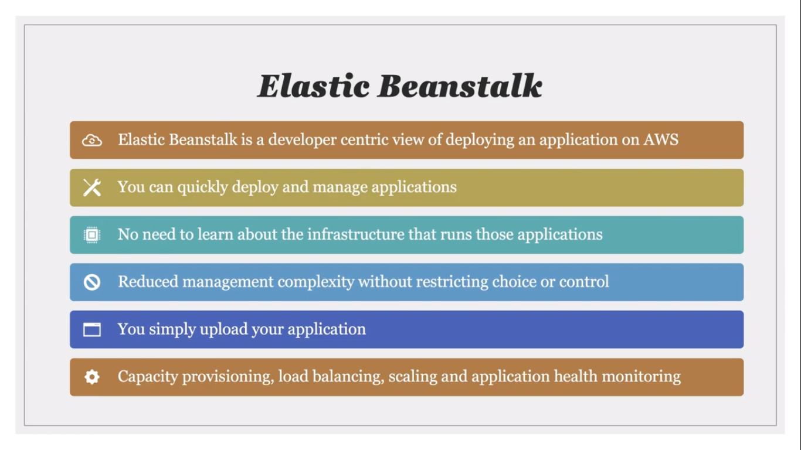

Slide 8
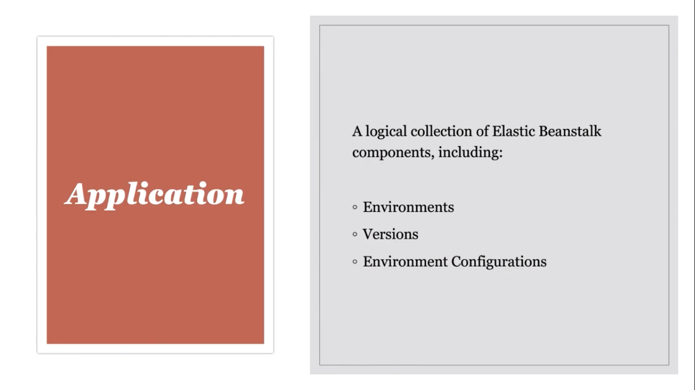
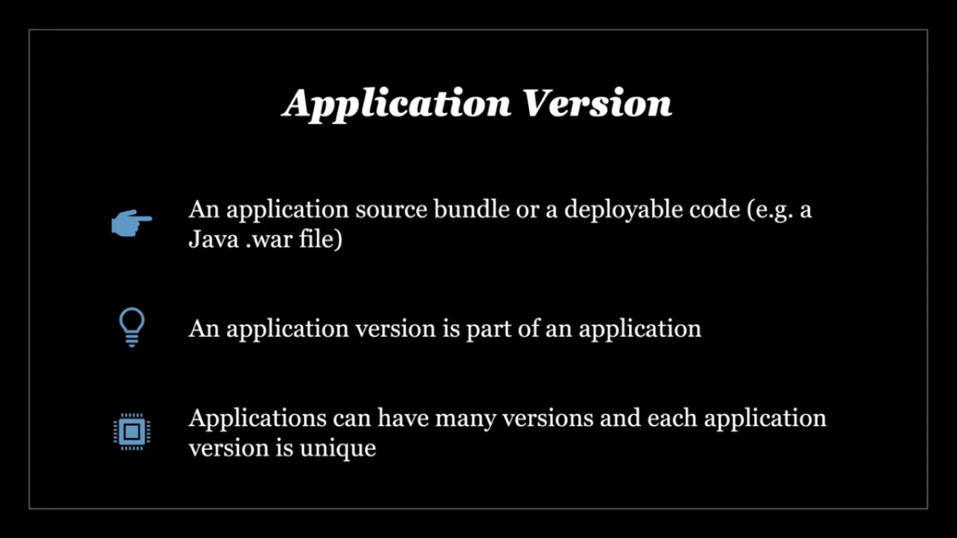
Components of EB

Slide 9
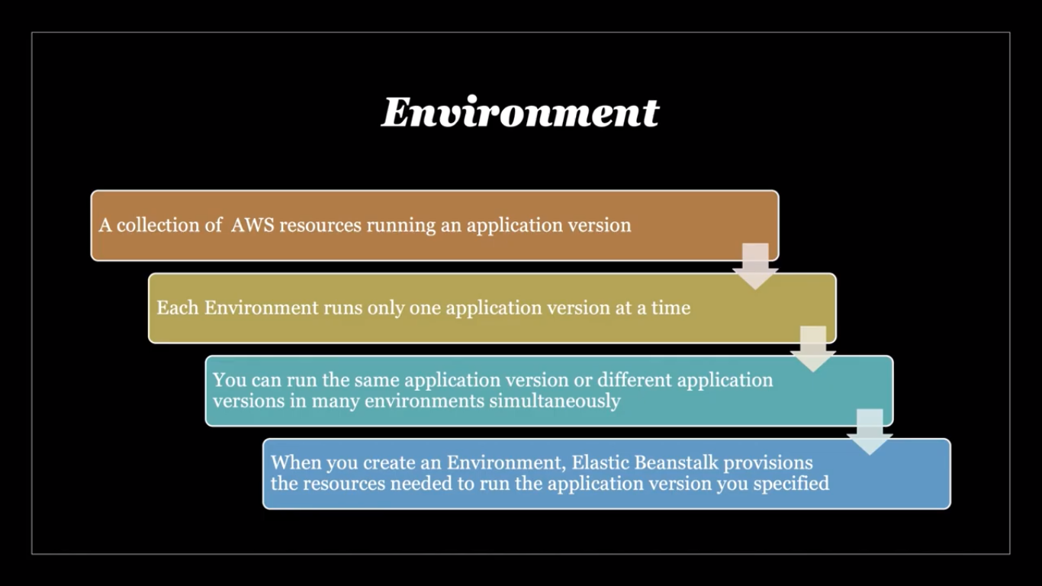
Components of EB

Slide 10
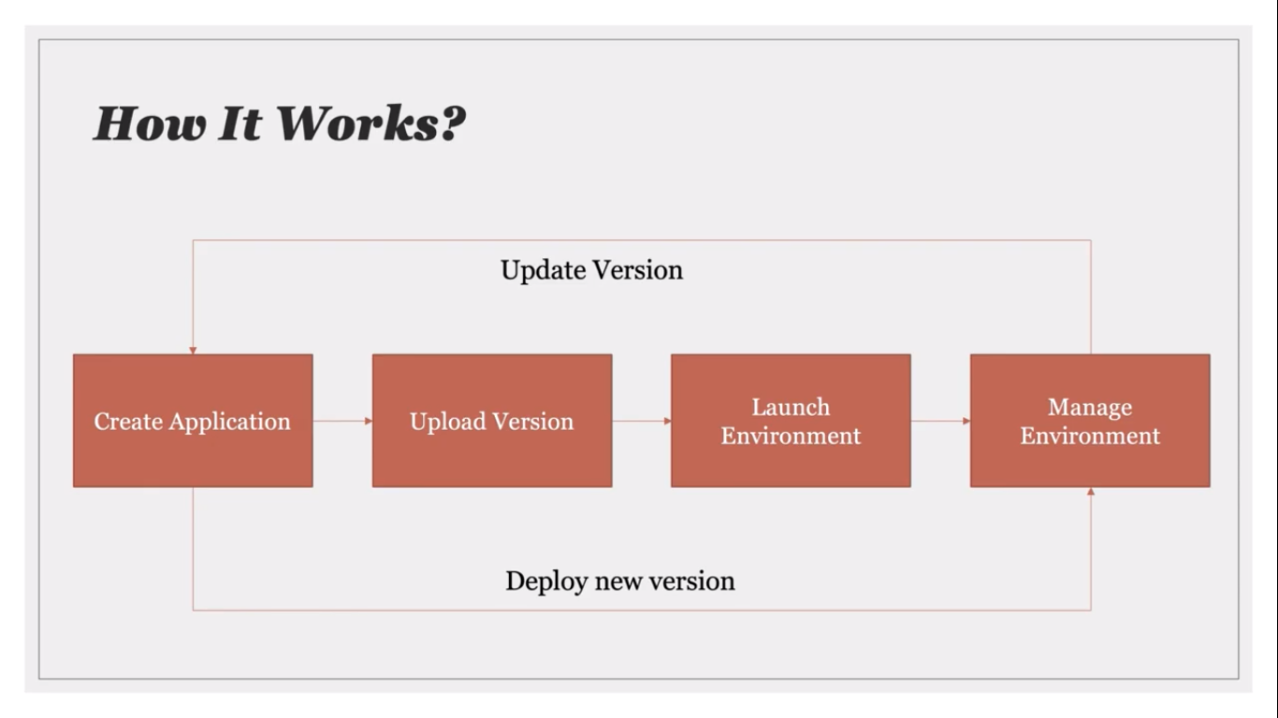

Slide 11
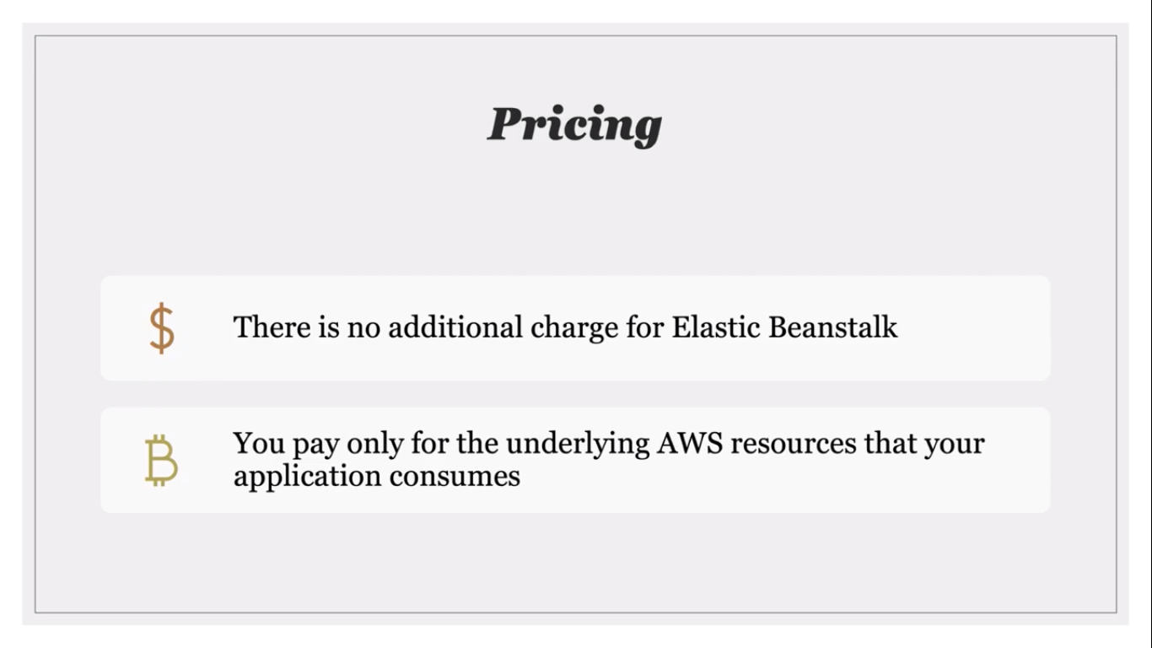

Slide 12
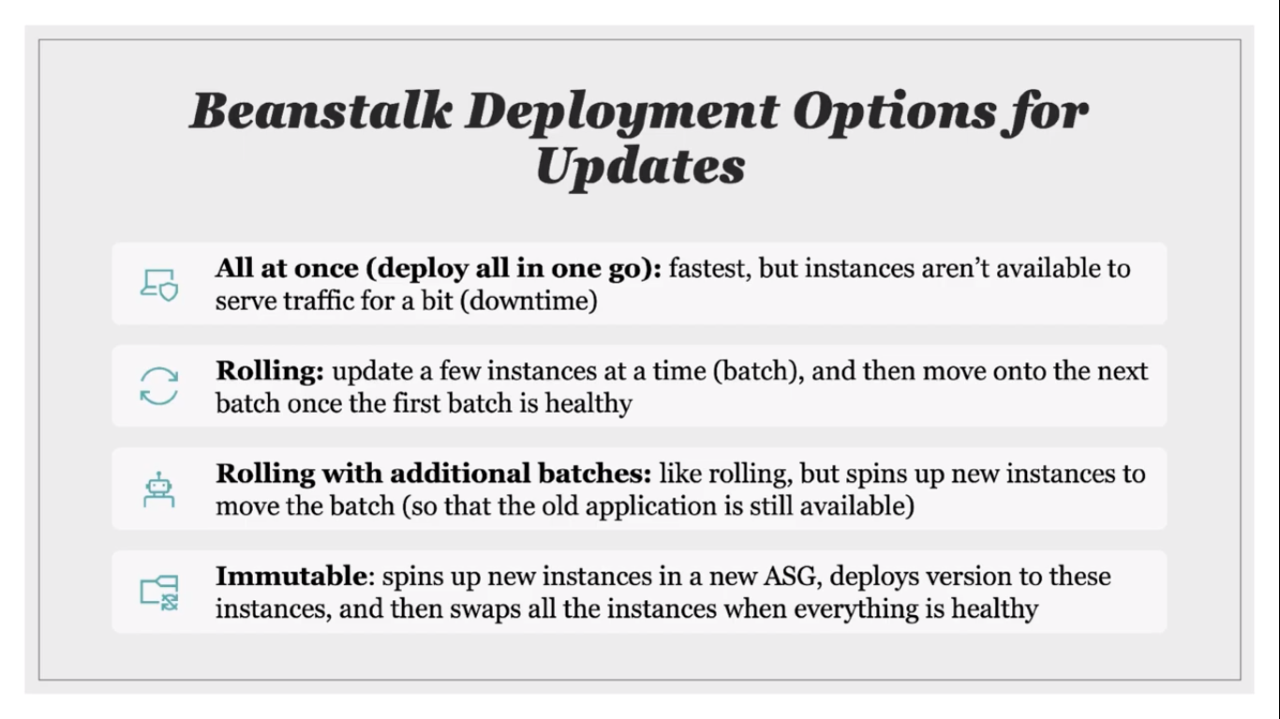

Slide 13
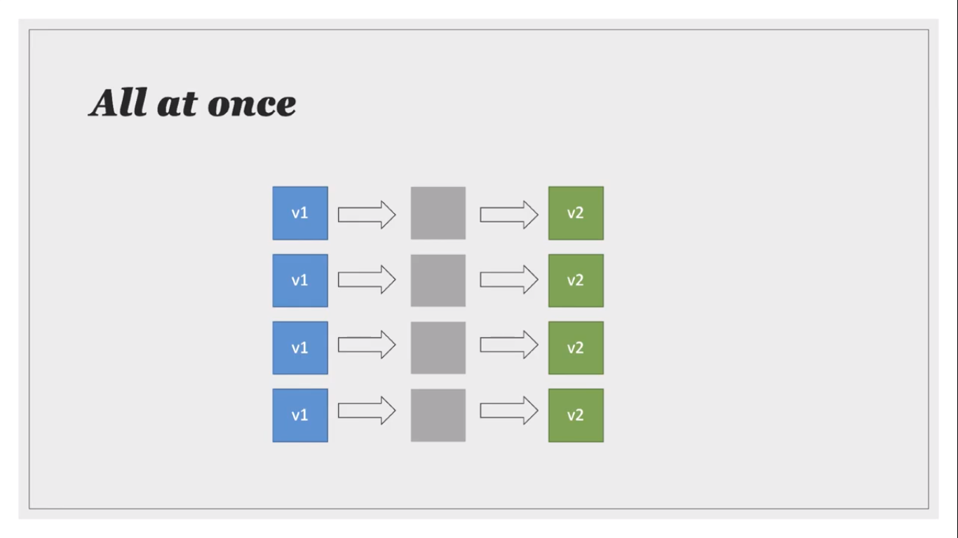

Slide 14
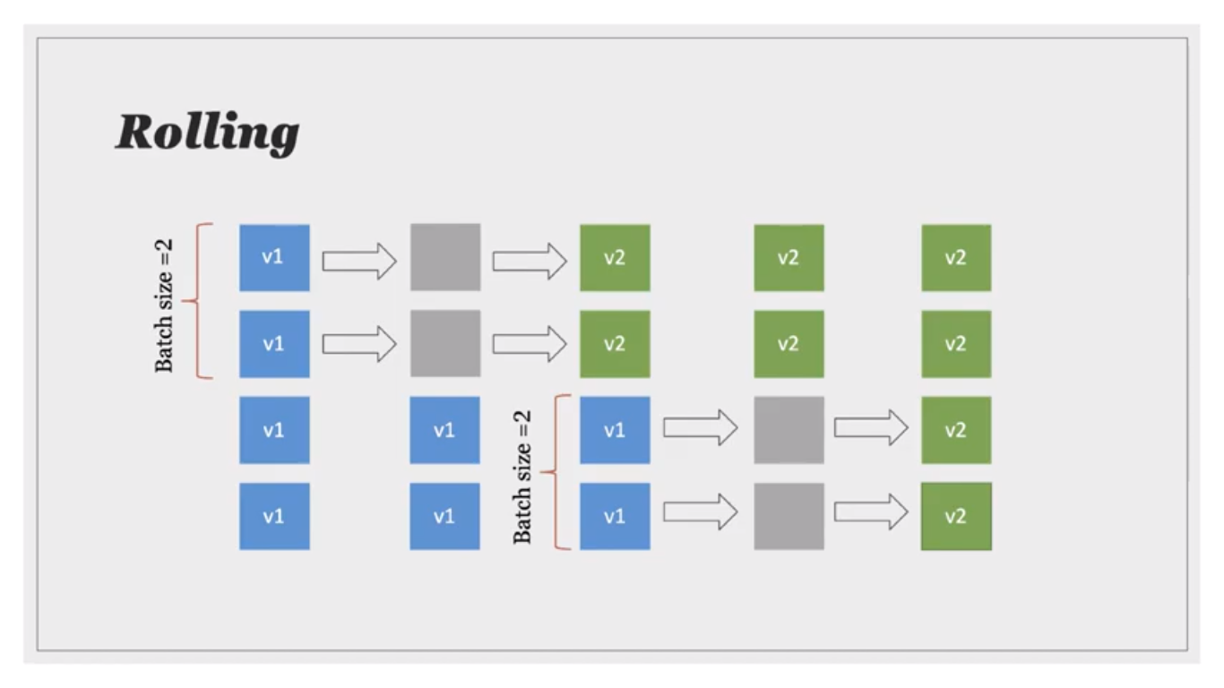

Slide 15
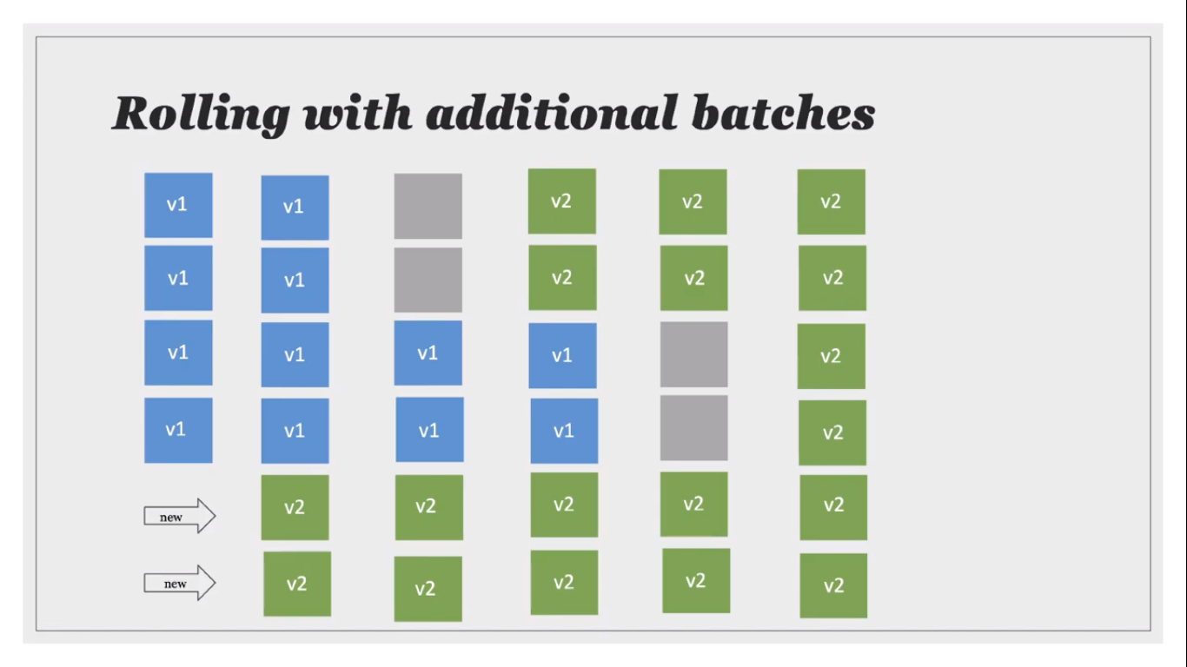

Slide 16
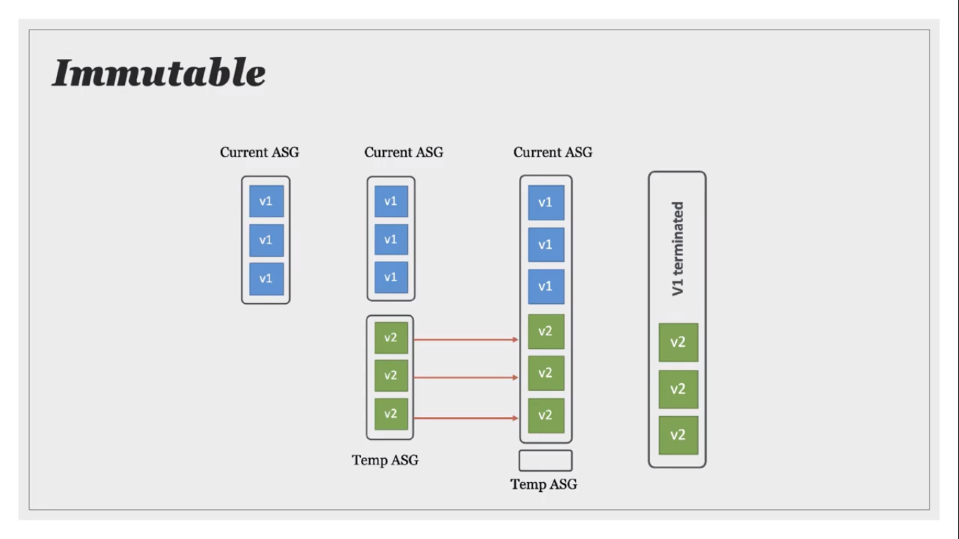

Slide 17
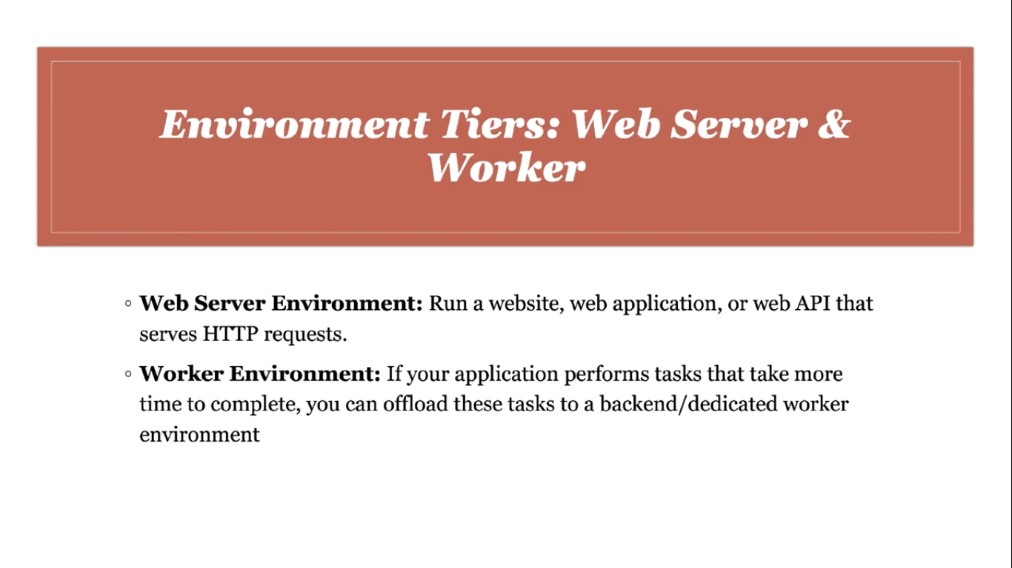

Slide 18
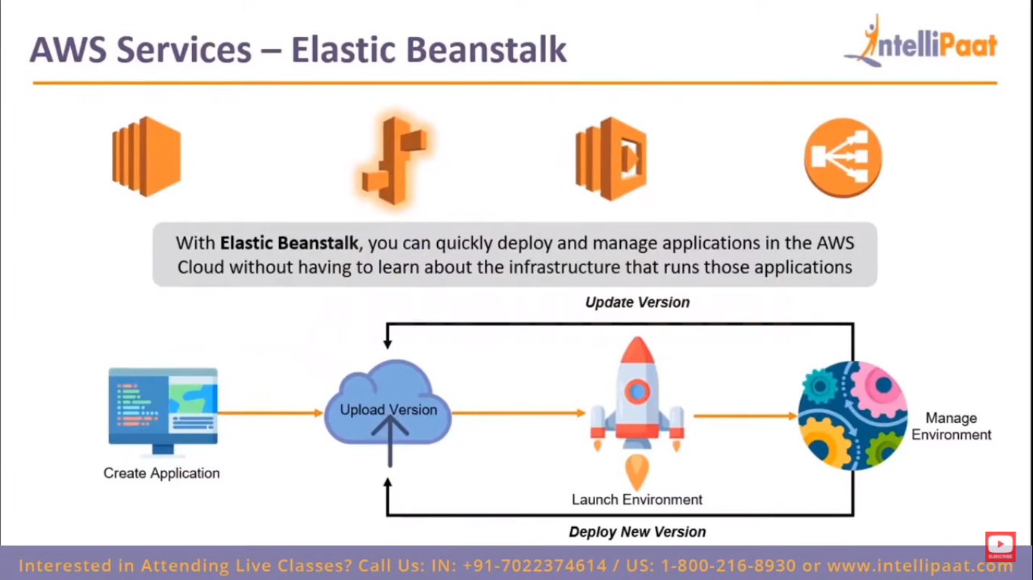

Slide 19
LABS
Create a test environment using Sample Application
Create another Prod Environment
Update the Application in Test Environment using Immutable Deployment method
Create Third Deploy Environment & configure options & use Test env & update
1) ion

Slide 20
AGENDA DAY 2
NEED OF CLOUD FORMATION
Concept OF CLOUDFORMATION
Working
JSON & YAML Formats
LABS
Create a Infrastructure using Designer
Create setup using Sample Template
Designing Infra using our own source code.
Deleting the Resources used in the Design

Slide 21
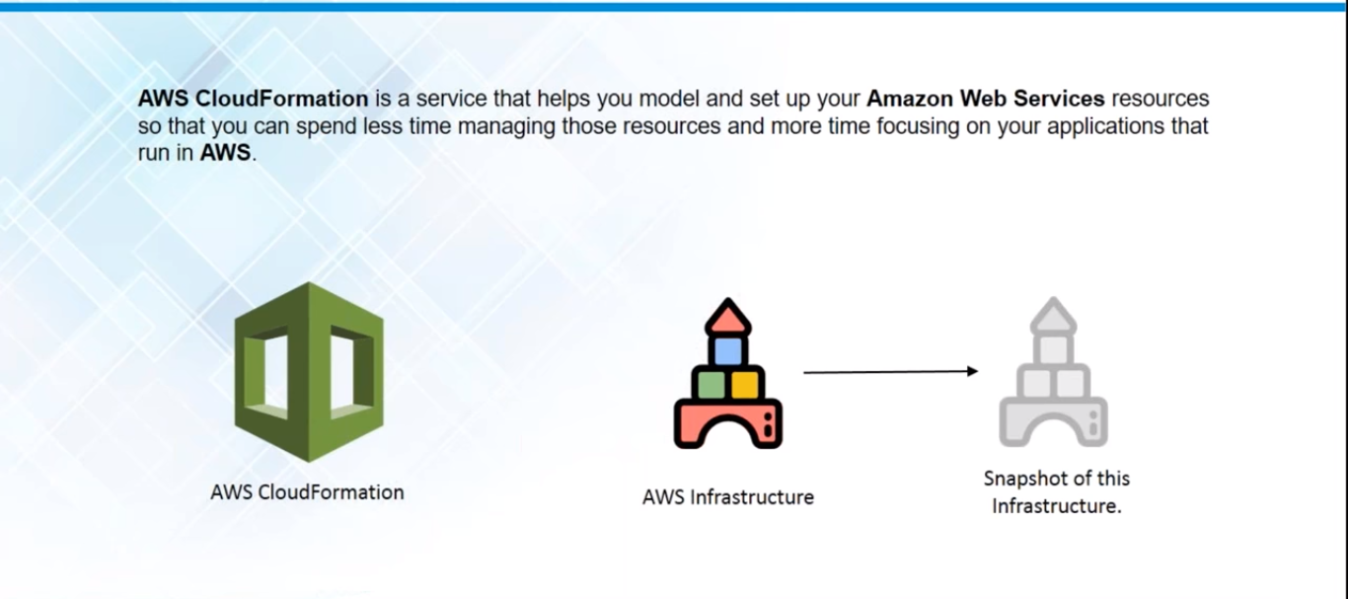
CLOUD FORMATION

Slide 22
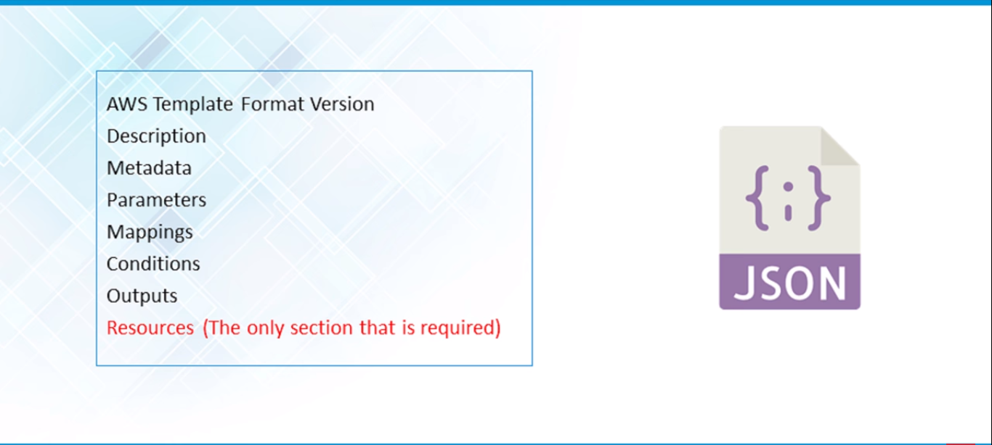
Structure of JSON Format

Slide 23
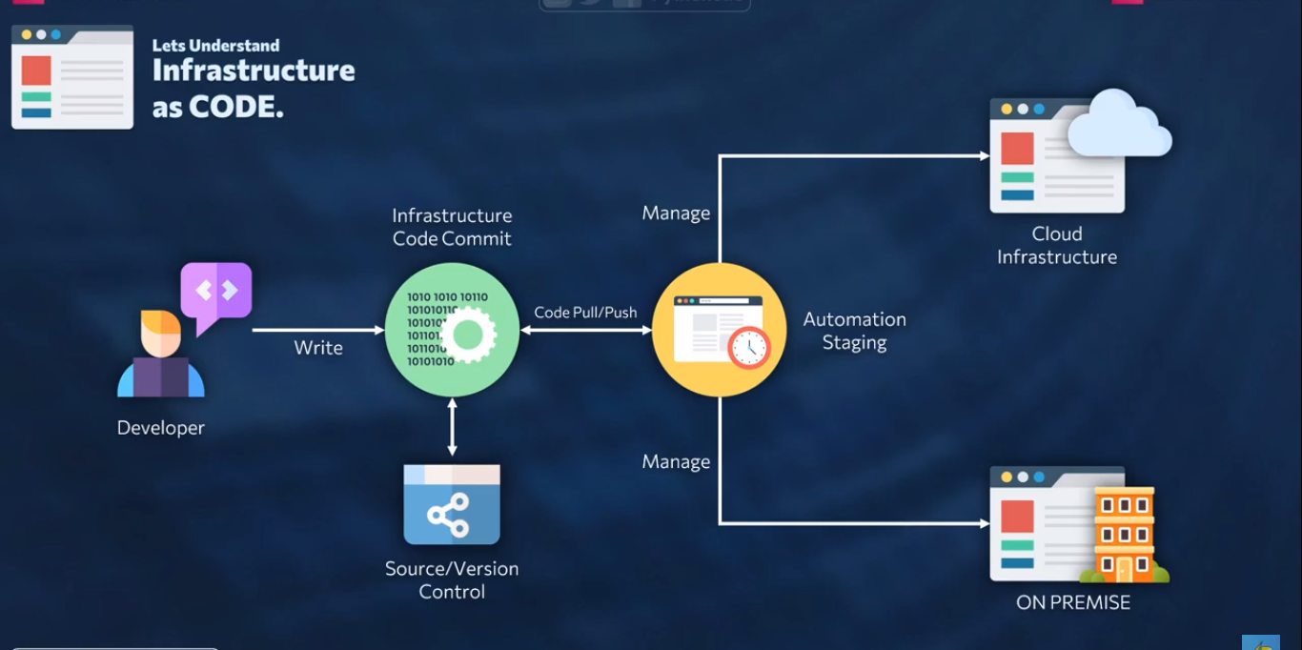
Infrasturcture as CODE

Slide 24
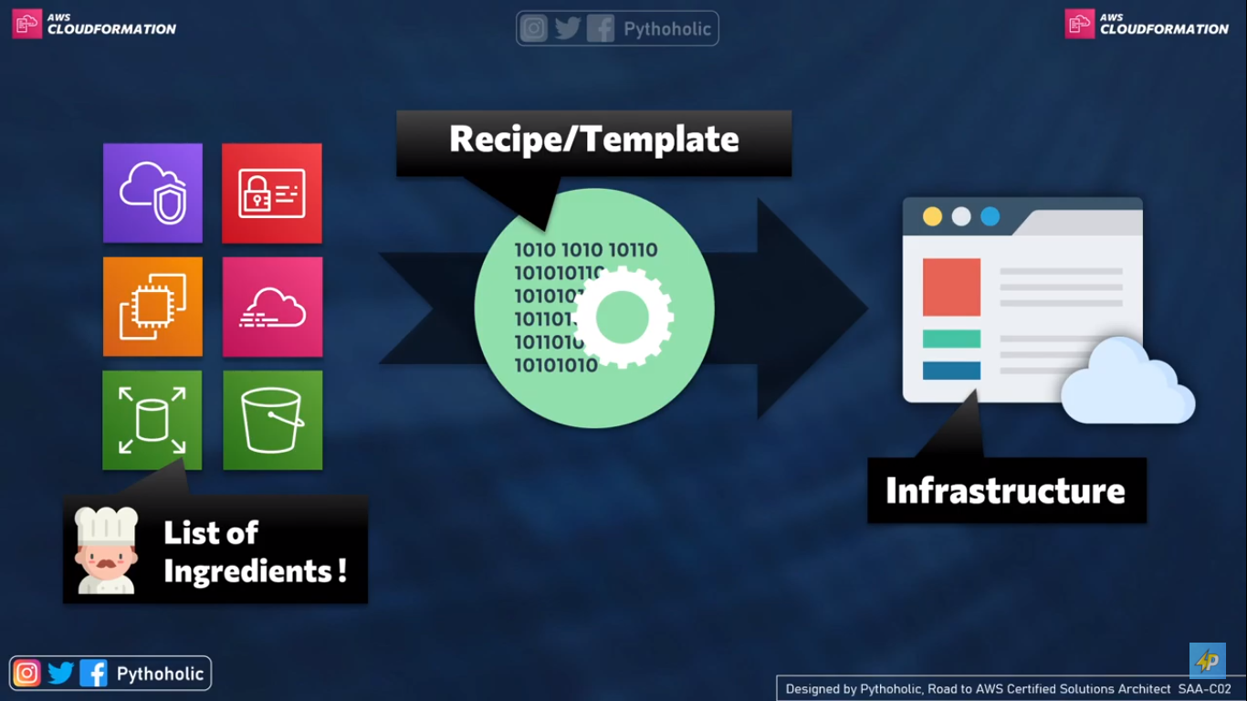
Working

Slide 25
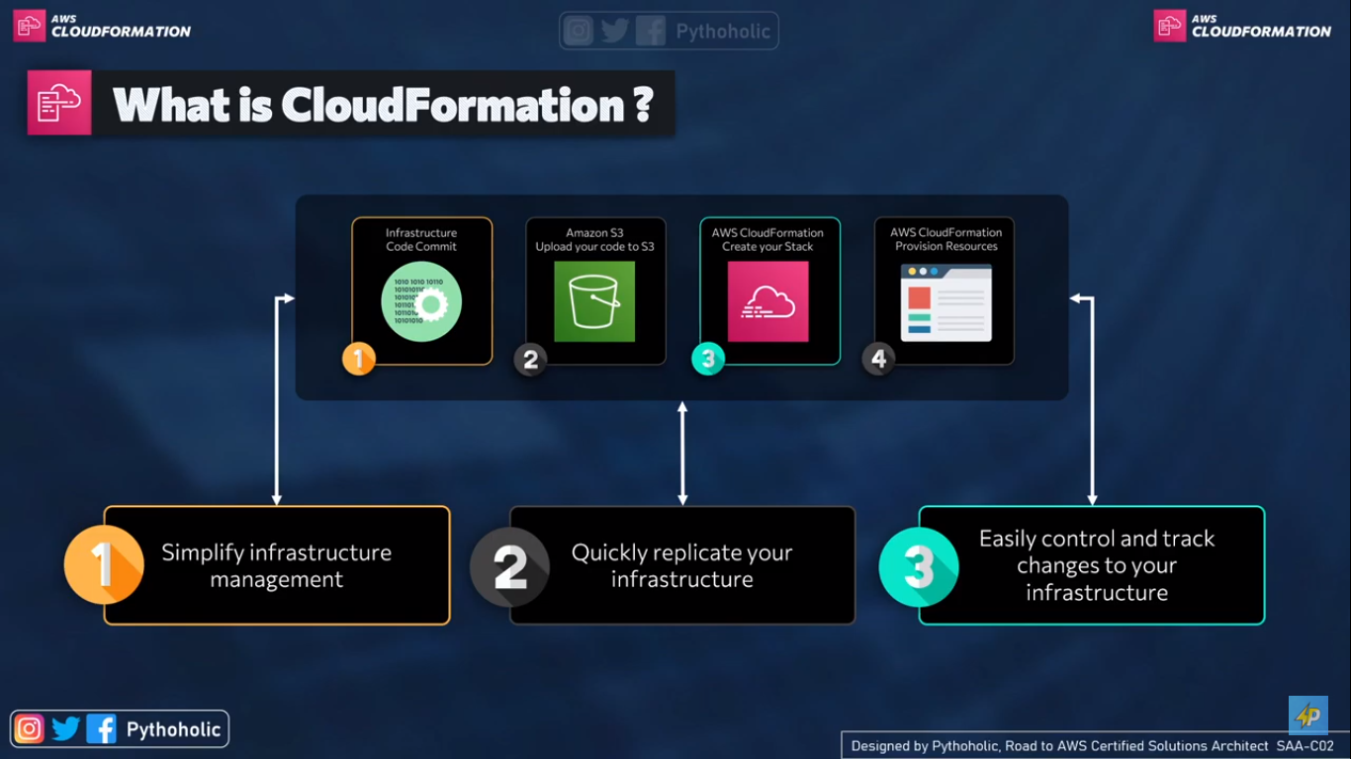

Slide 26
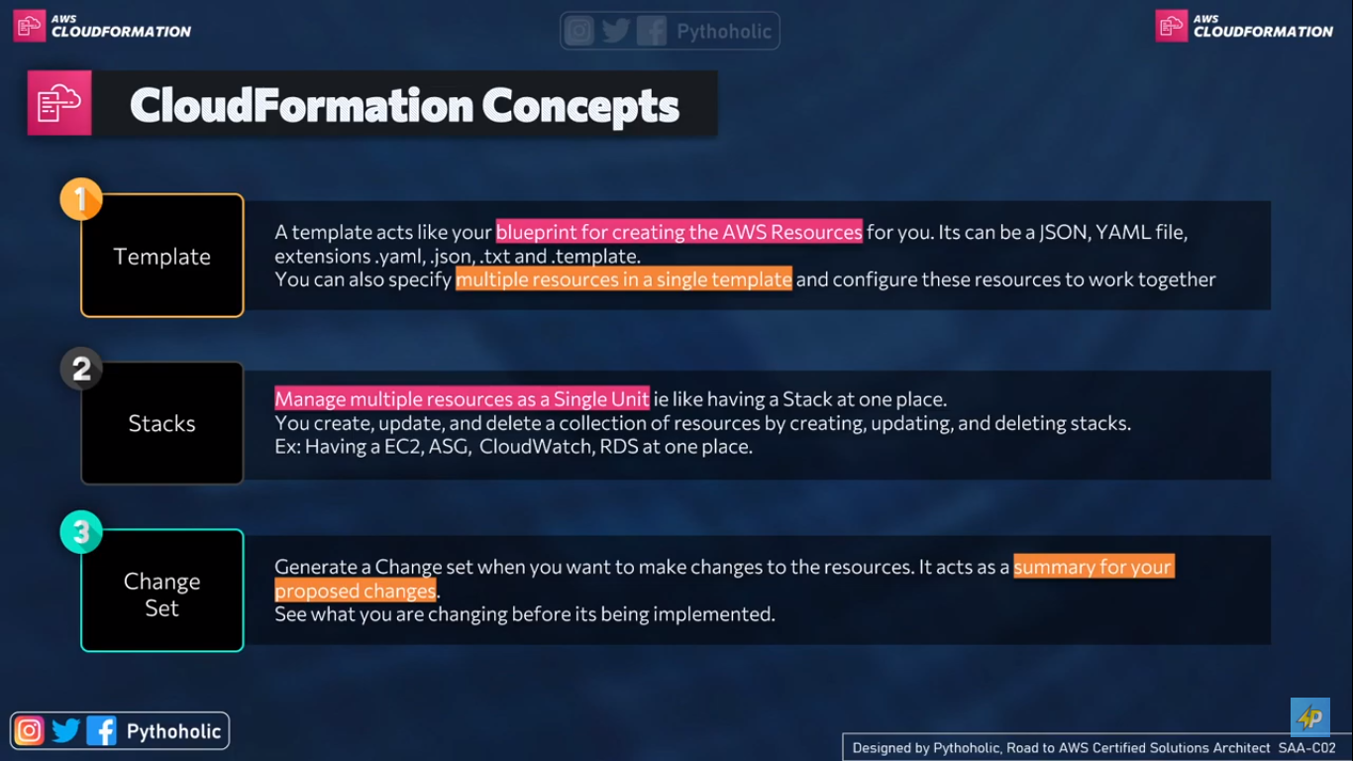

Slide 27
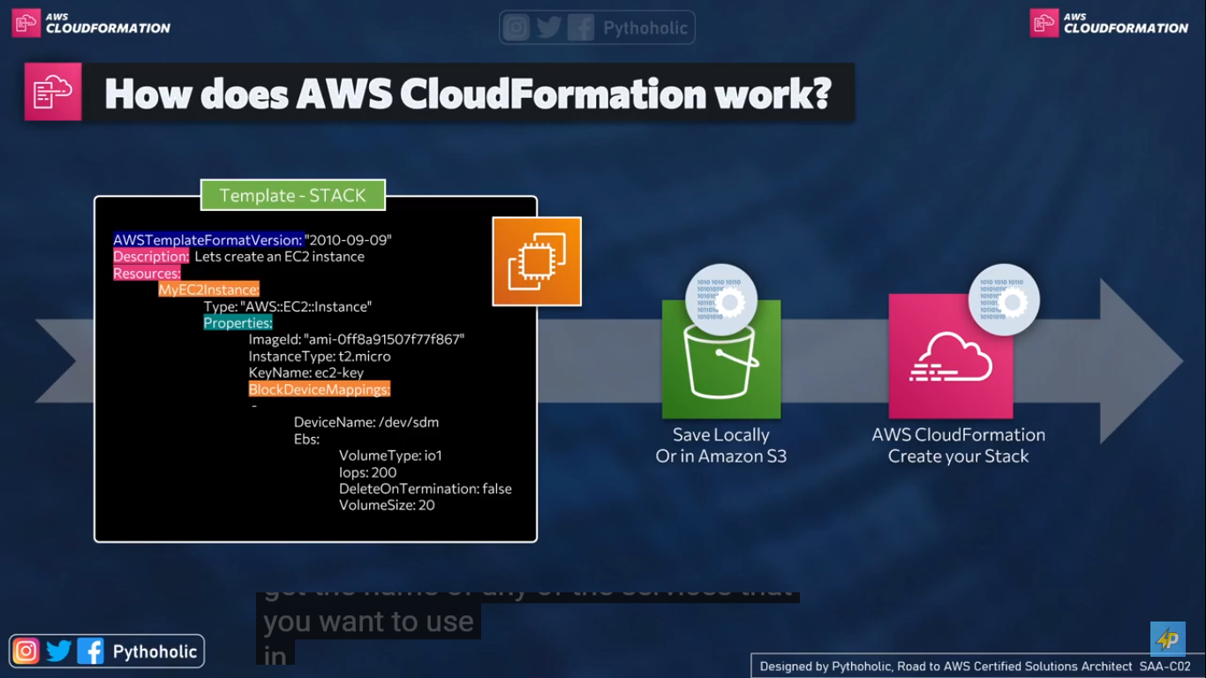

Slide 28
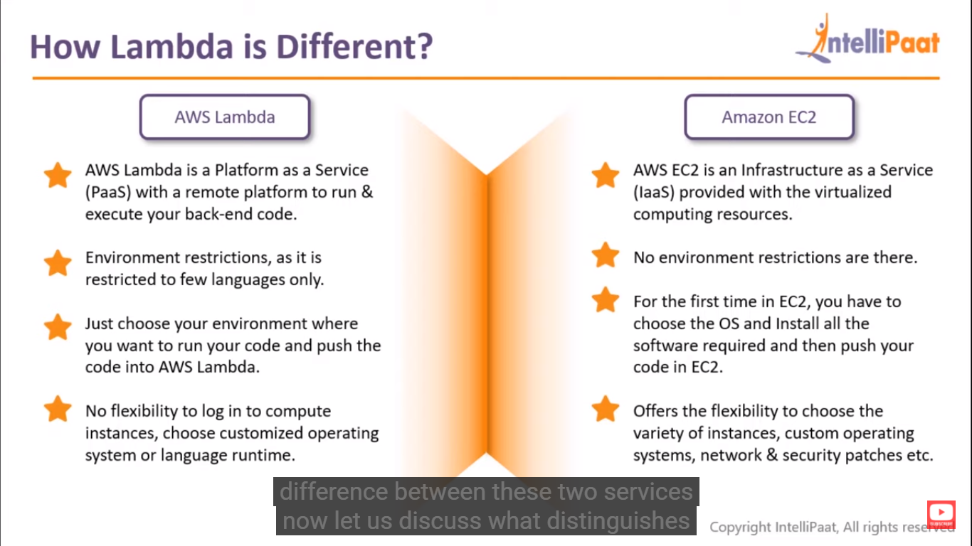

Slide 29
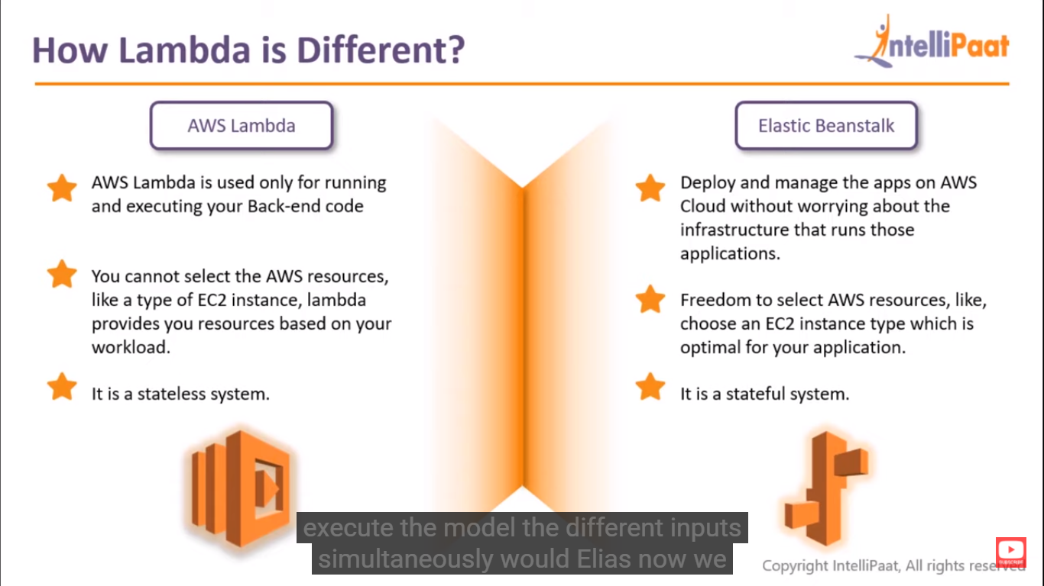

Slide 30
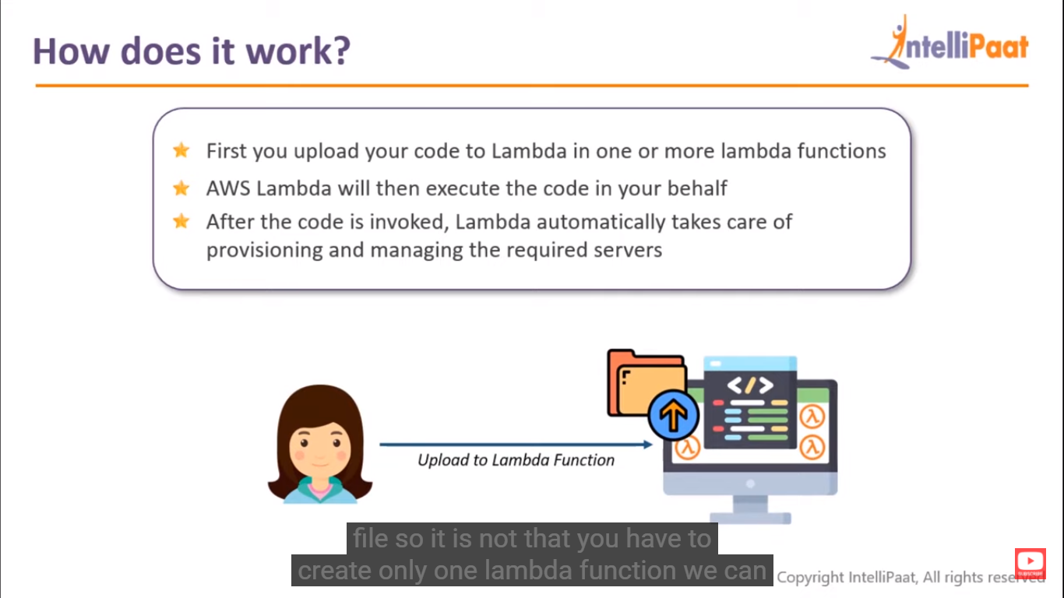

Slide 31
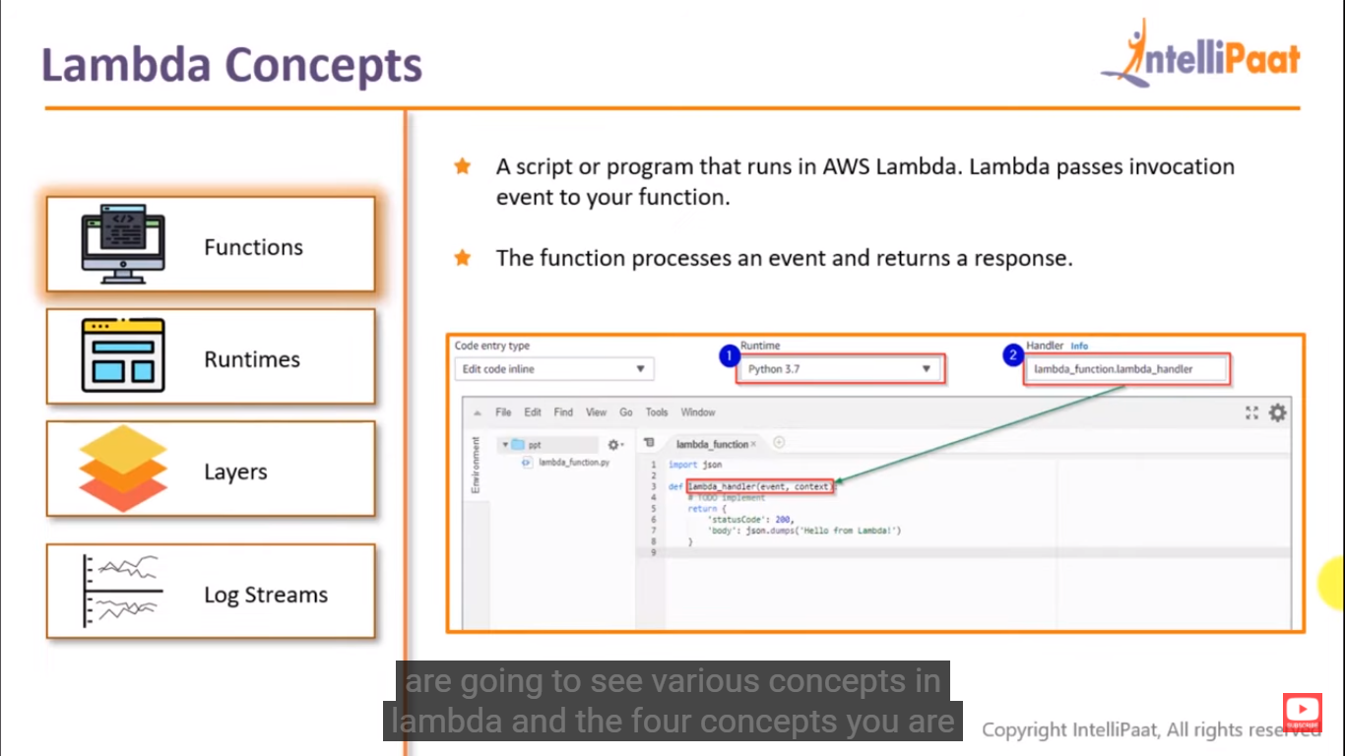

Slide 32
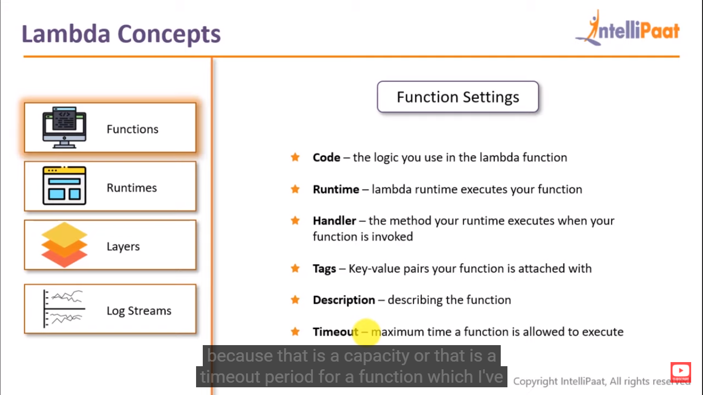

Slide 34
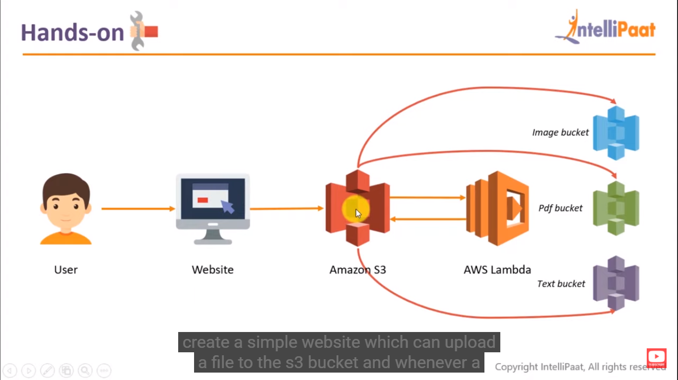

Slide 35
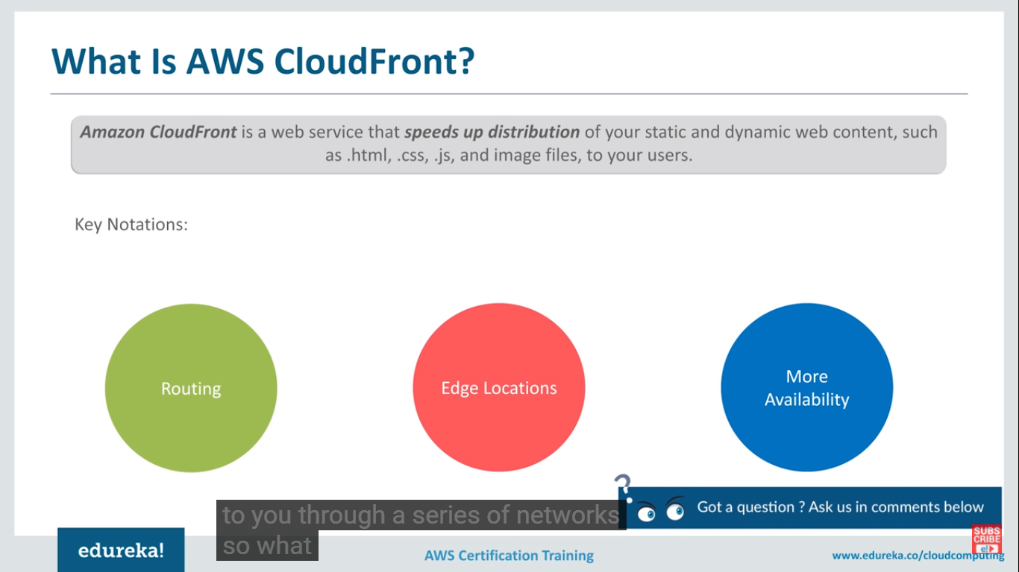

Slide 36
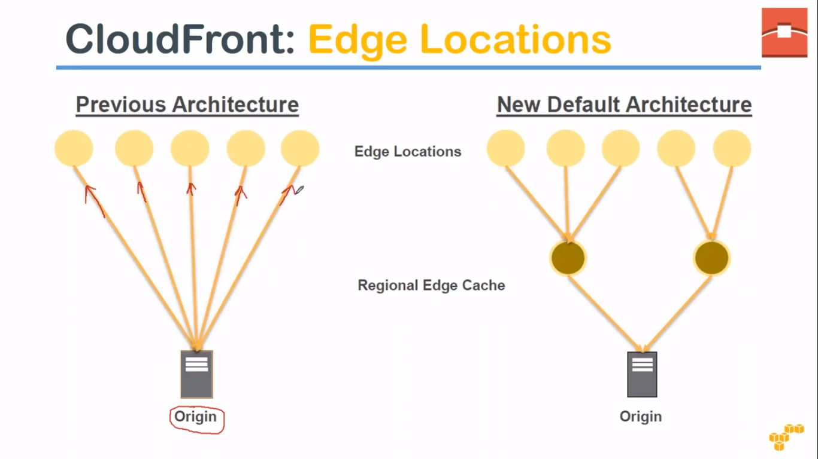

Slide 37
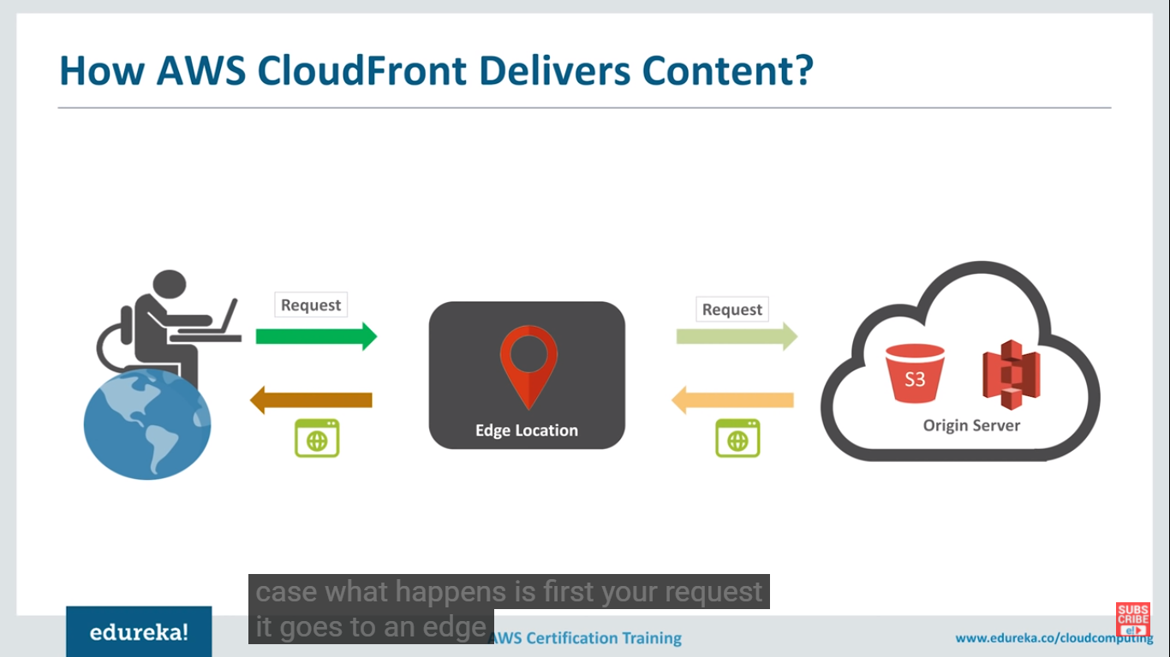

Slide 38
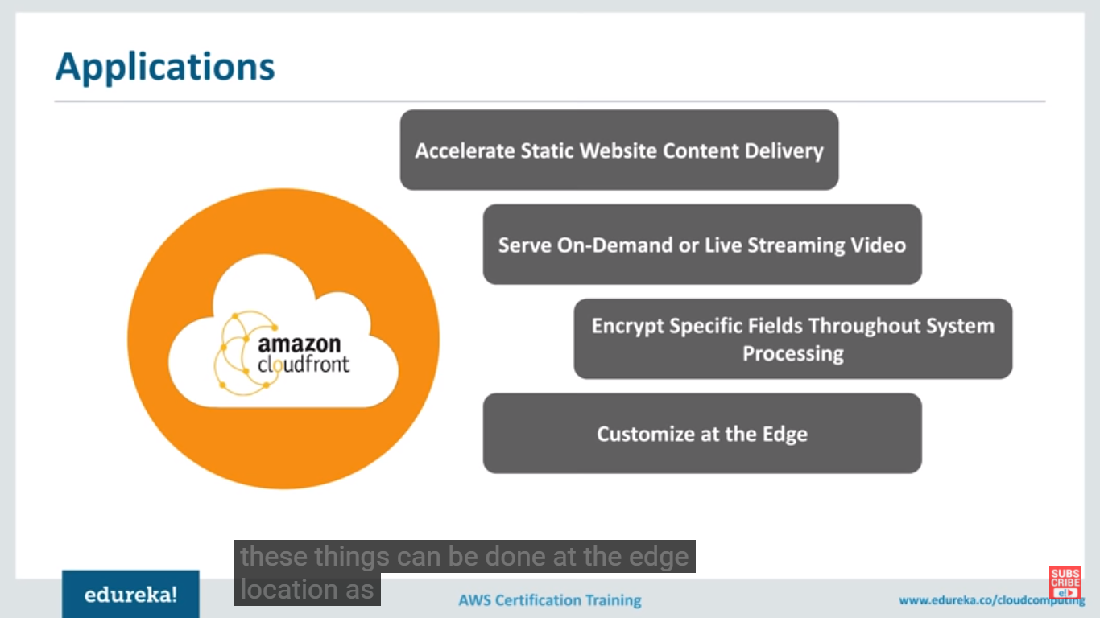

Slide 39
Edge location-we don’t have to configure any server, it stores the popular responses .it will remain for 24 hrs by default.
Regional edge location- Amazon has added several regional edge location.
Cache is bit larger
Reduce the burden of origin
Parity with edge location- a cache invalidation request removes object from edge & regional locations
Whenever user tries to access data from specific country, he will be automatically routed to nearest edge location server.
Low latency with best possible performance

Slide 40
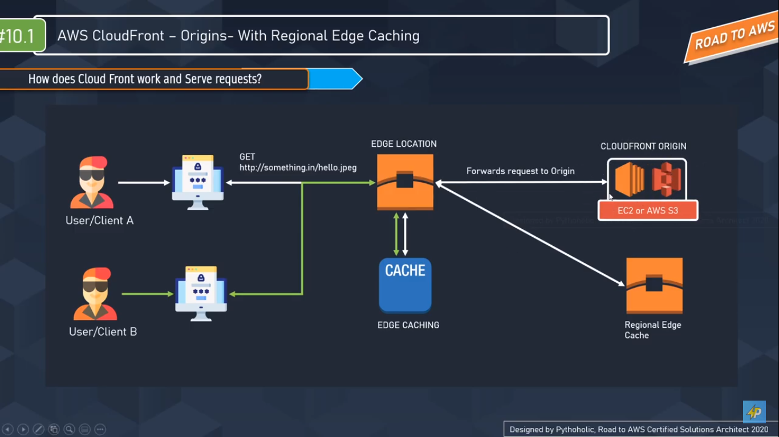

Slide 41
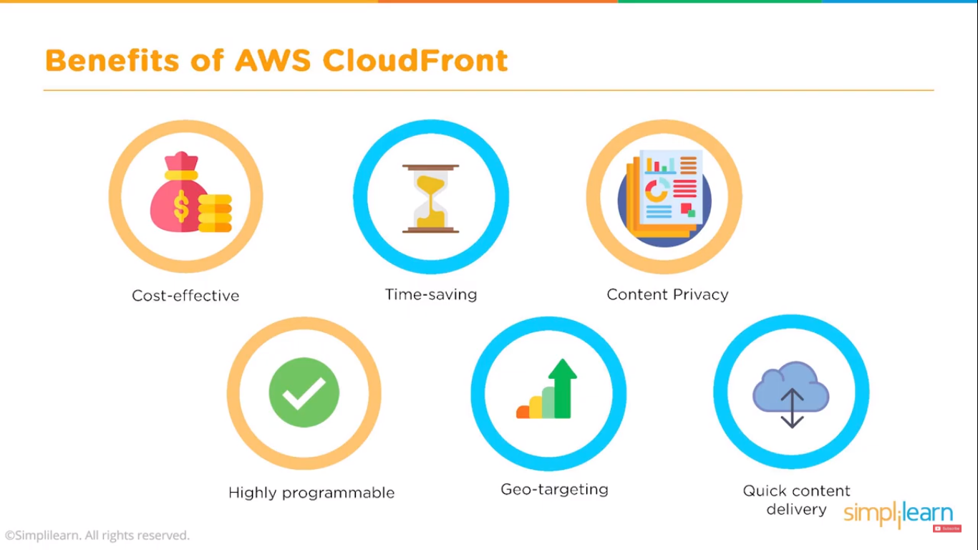

Slide 42
SECURITY
Authentication
Username/password
Key based authentication(Kerberos )
CA(Certificate Authority)
Encyption– DES, 3DES, AES(256-bit)
Convert text to Cipher
PKI (Public Key Infrastucture)
Cryptography ( Hash Algorithm)
Pubic- Private
Integrity (
MD5(Message Digest 5)
SHA512( Secure Hash Algorithm)
VPN(Virtual Private Network)
Tunnel --PPTP, L2TP
CA
Verisign
Entrust
Https://sbibank.con

Slide 43
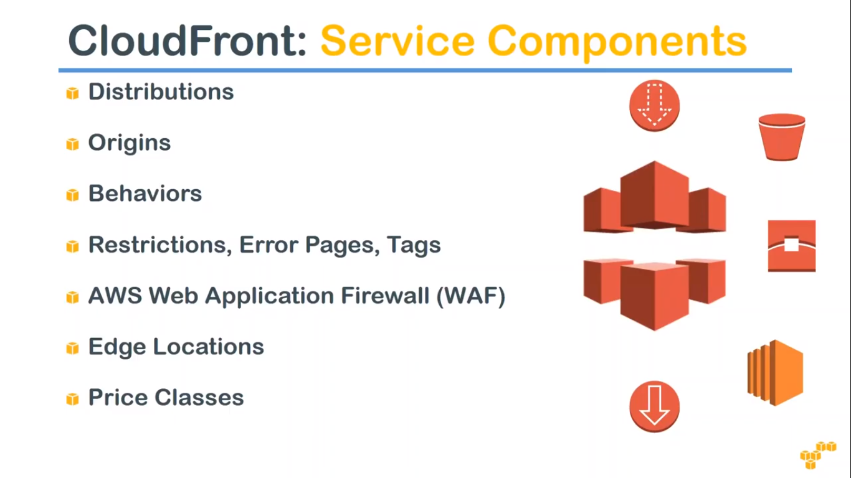

Slide 44
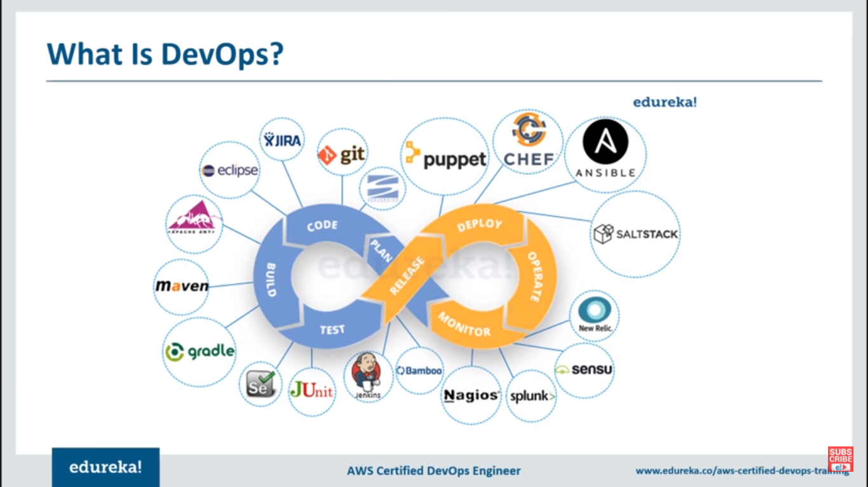

Slide 45
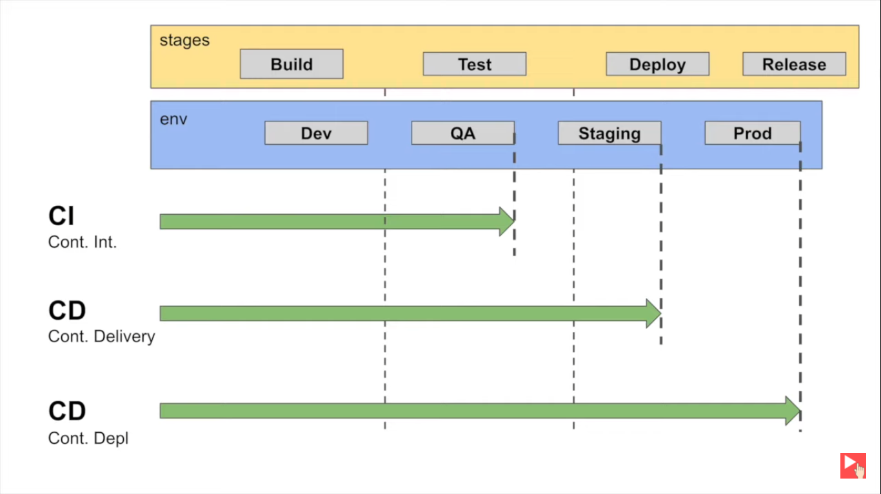

Slide 46
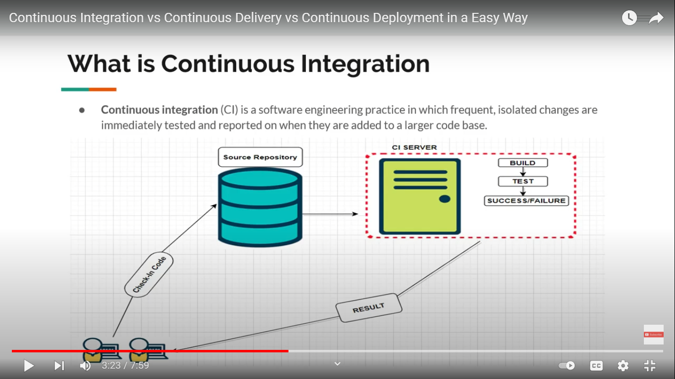

Slide 47
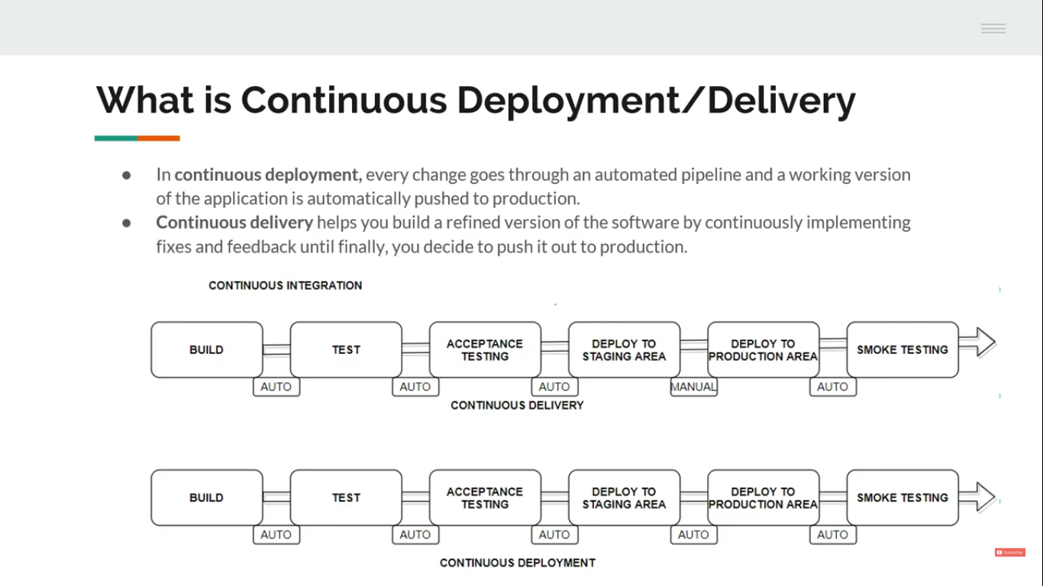

Slide 48
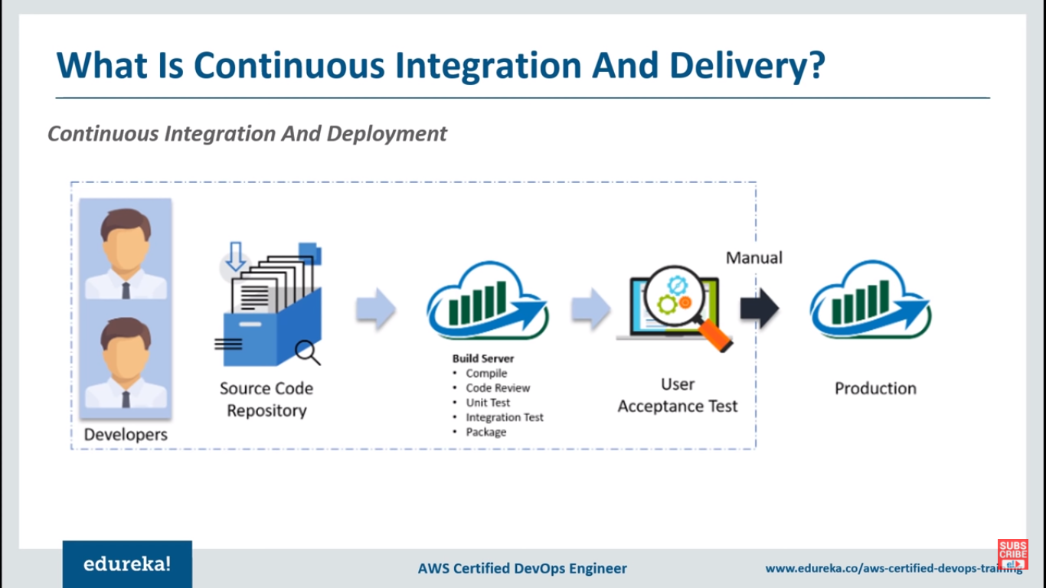

Slide 49
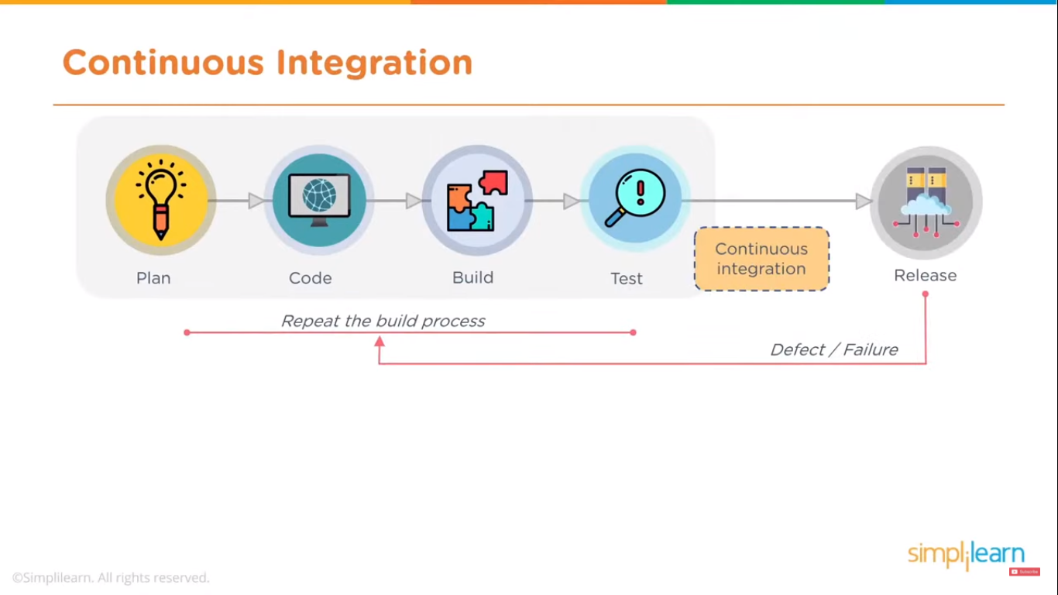

Slide 50
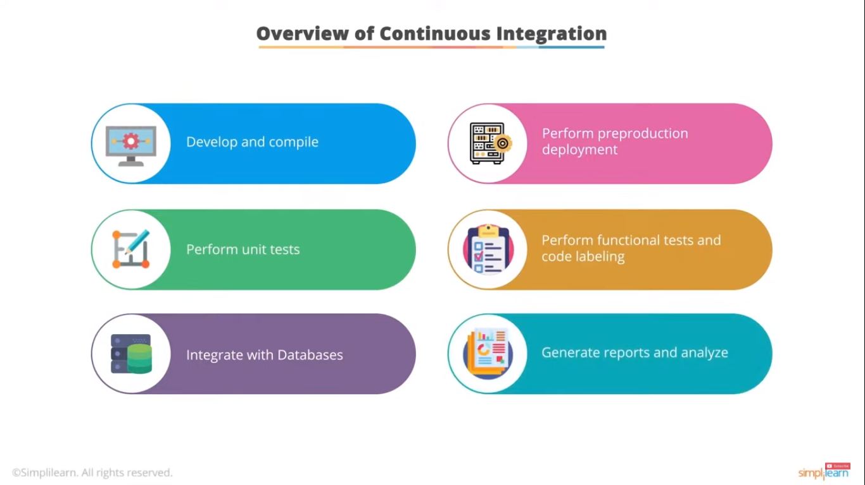

Slide 51
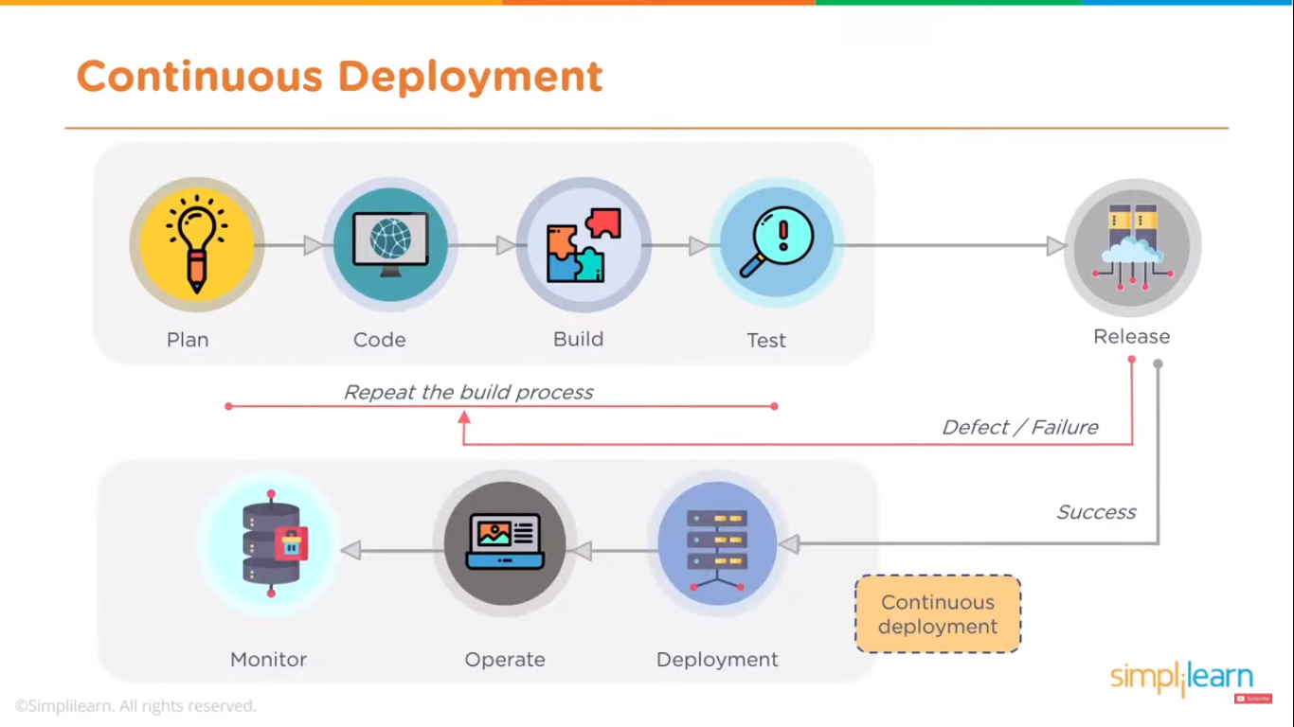

Slide 52
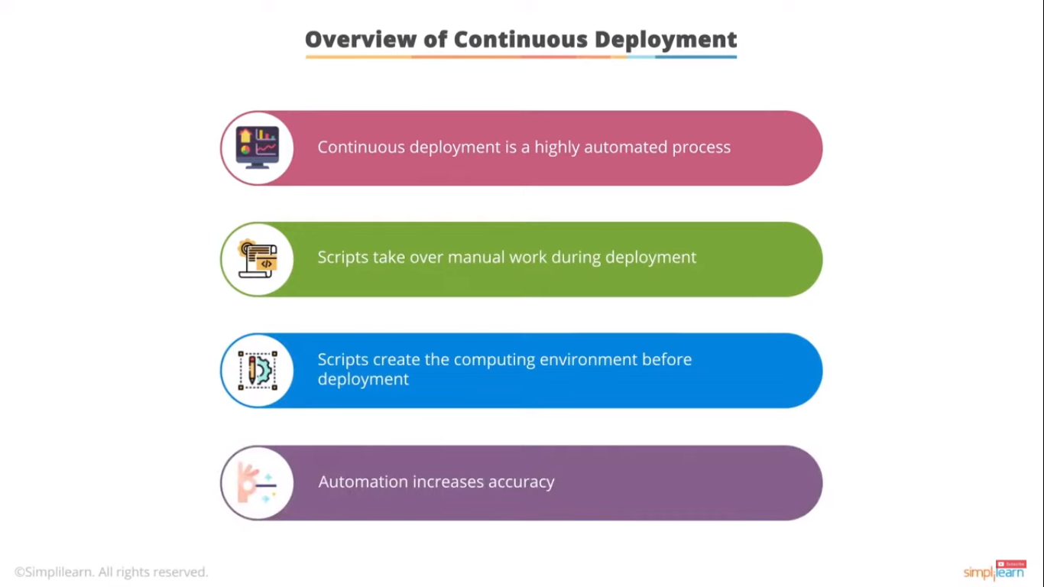

Slide 53
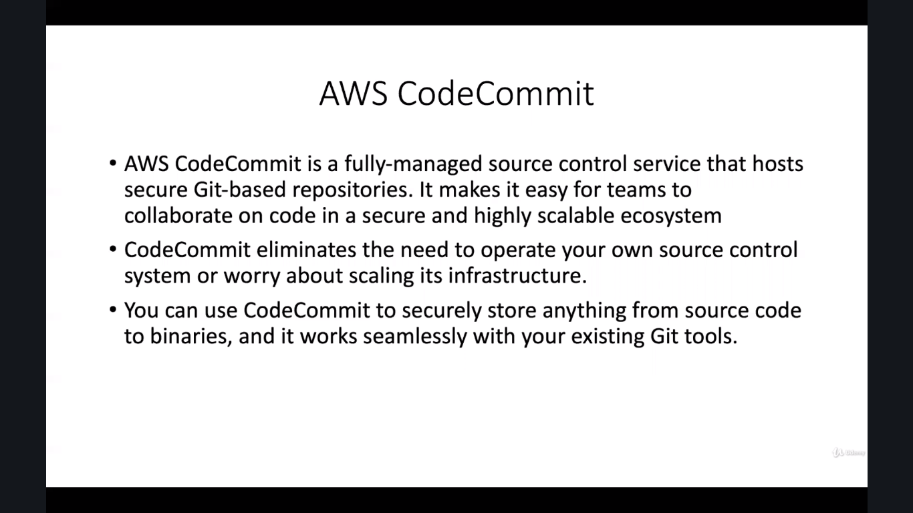

Slide 54
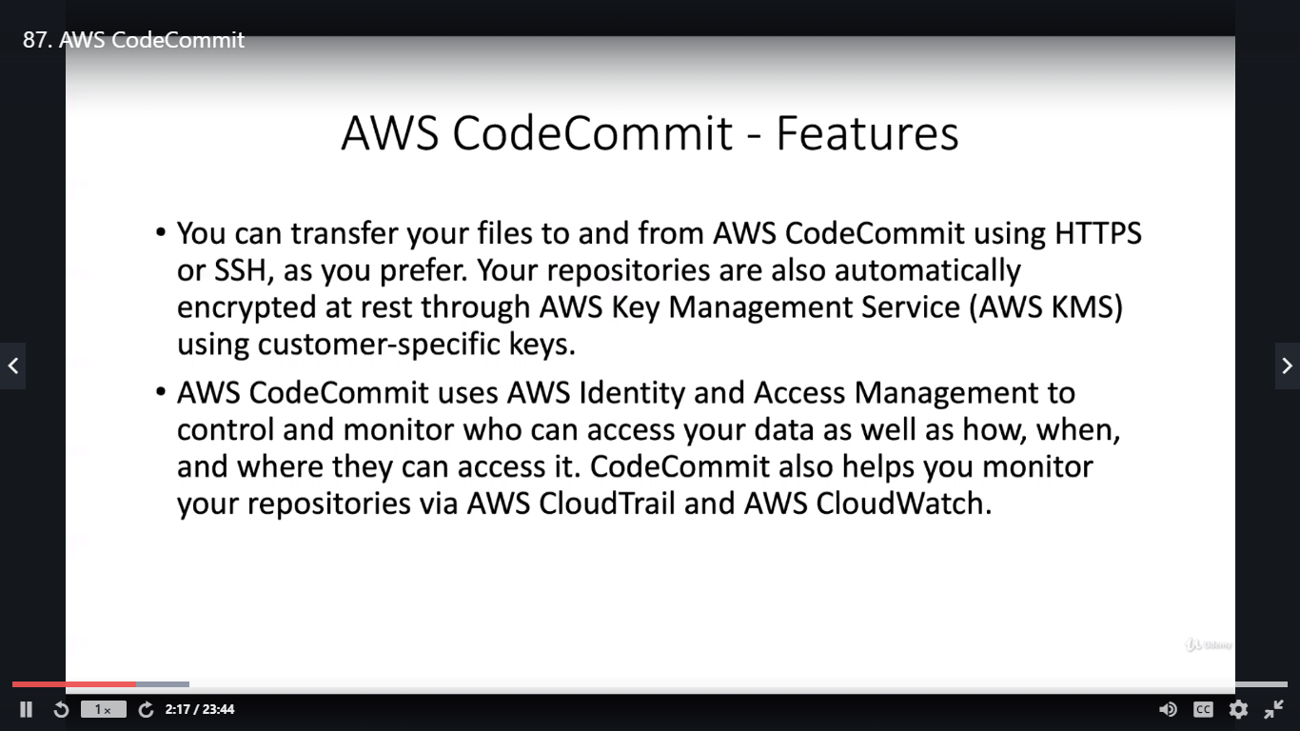

Slide 55
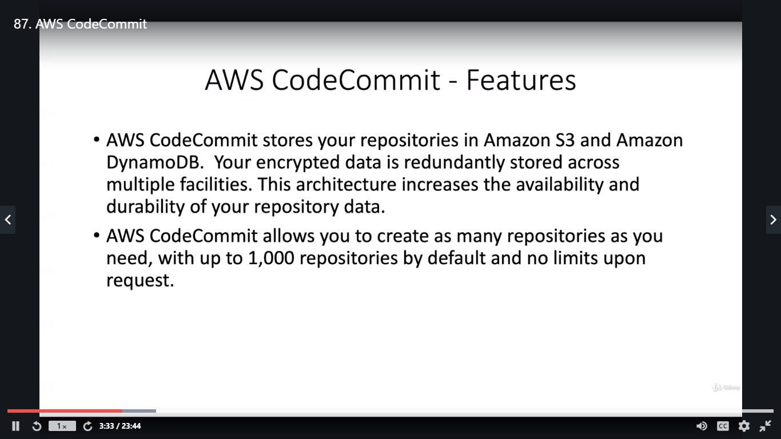

Slide 56

Code Build

Slide 57


Slide 58


Slide 59


Slide 60


Slide 61


Slide 62


Slide 63


Slide 64


Slide 65


Slide 66


Slide 67


